Slide 1
Lecture 8
Practice, pt.2
Konstantin Leladze
C++ Basics
DIHT MIPT 2021

Slide 2
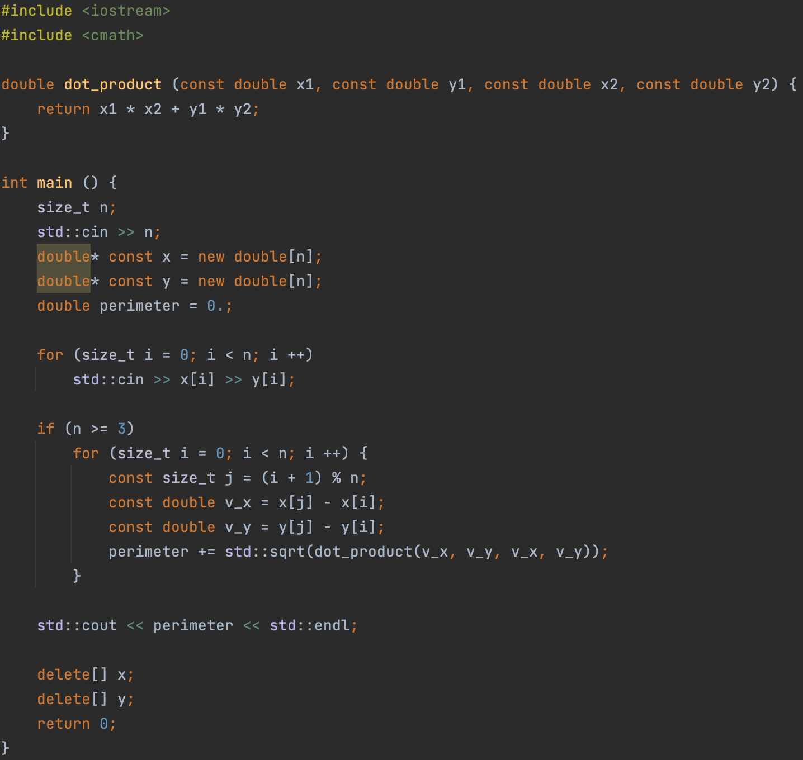
Problem
A sequence of 2D points is specified as a sequence of pairs (x, y).
It is necessary to find the perimeter of the polygon formed by a given set of points.
Points are given in order of counterclockwise traversal relative to the center of the polygon.

Slide 3
Hints on the first contest
And then at the lecture, I told some hints about how to solve problems of the first contest…

Slide 4
Lecture 8
Practice, pt.2
Konstantin Leladze
C++ Basics
DIHT MIPT 2021

